Slide 1
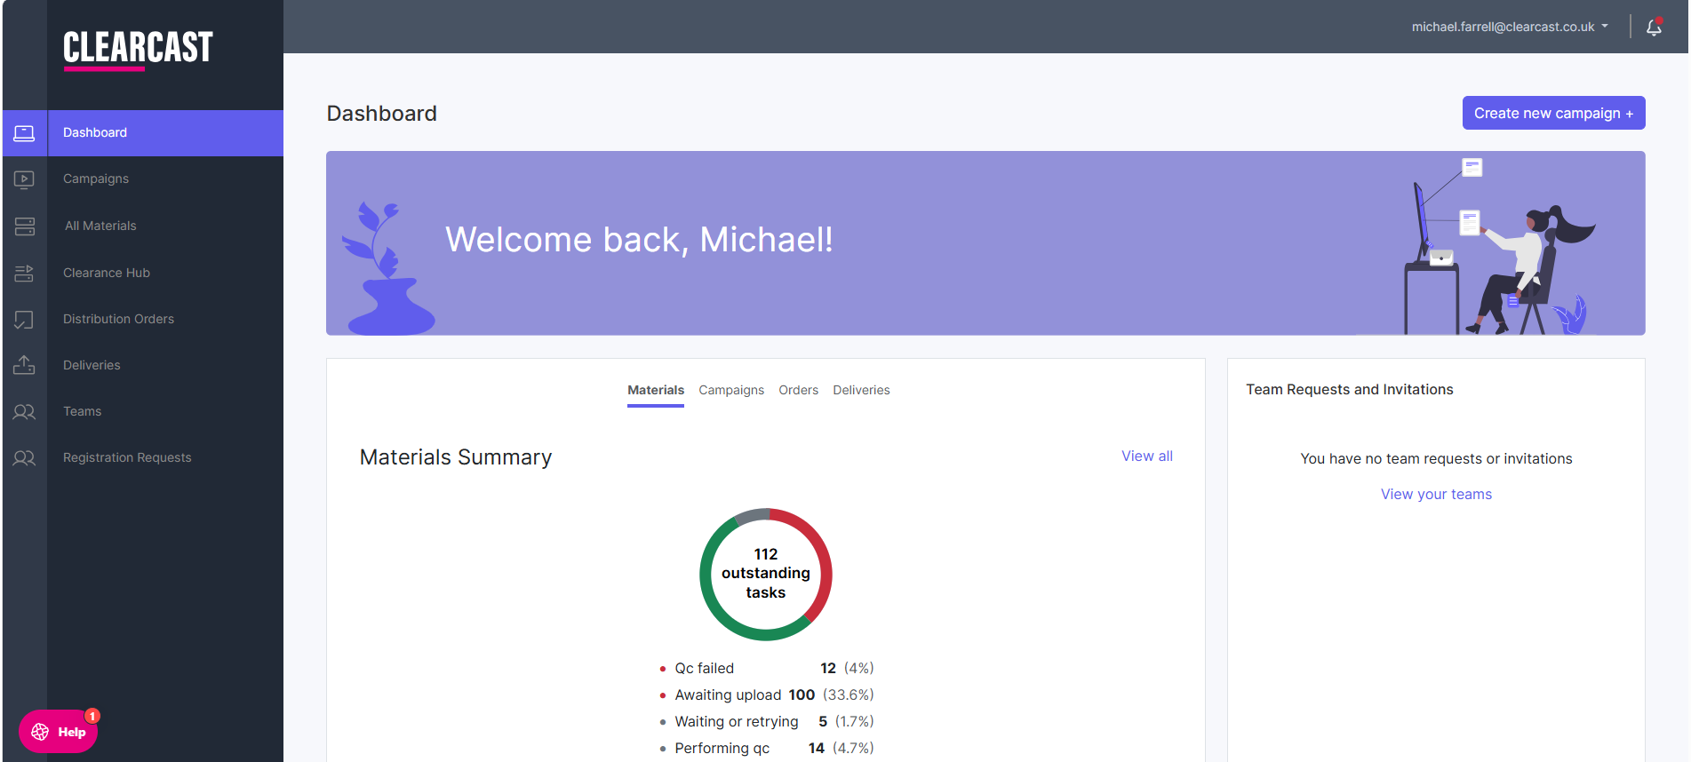
Quickly create your new campaign here.
This is your dashboard. Here you can access all areas of The Library.

Slide 2
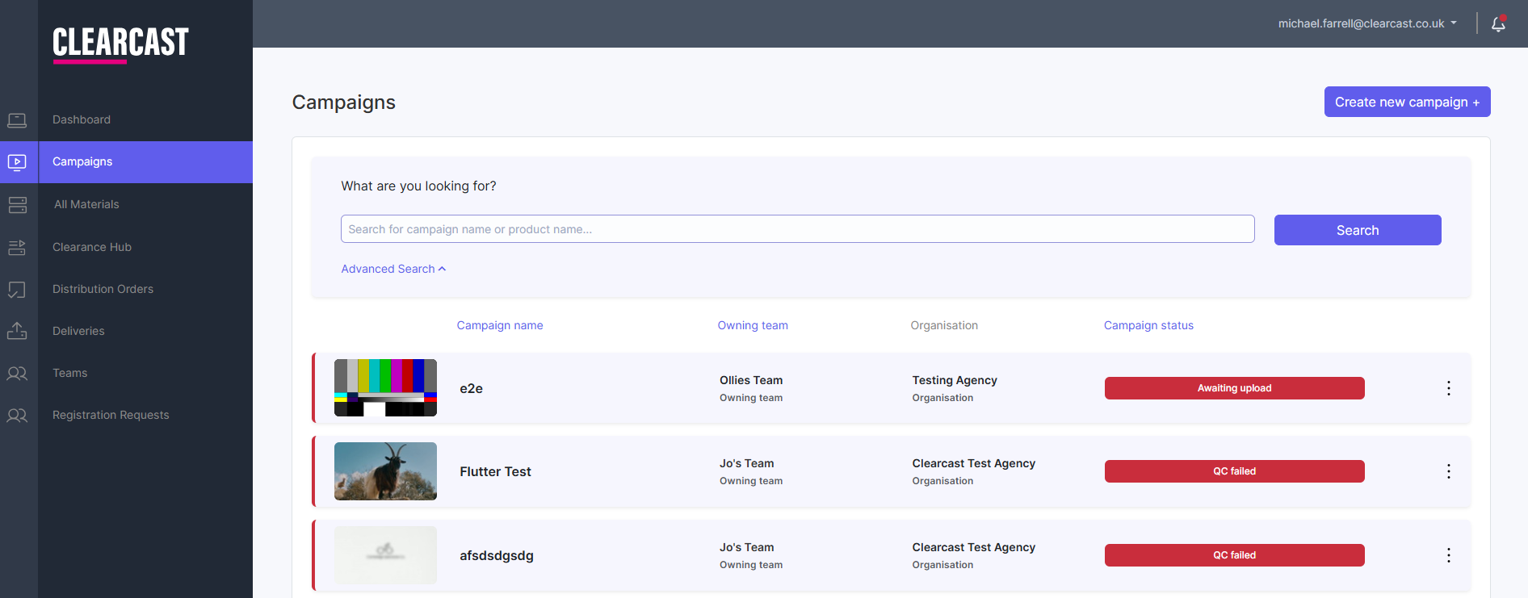
The campaign section within your dashboard will show all campaigns you have created.
Here you can search any of the campaigns you have created and ‘Advanced Search’ will allow your users to search using more specific filters.
You can also create your new campaigns here.

Slide 3
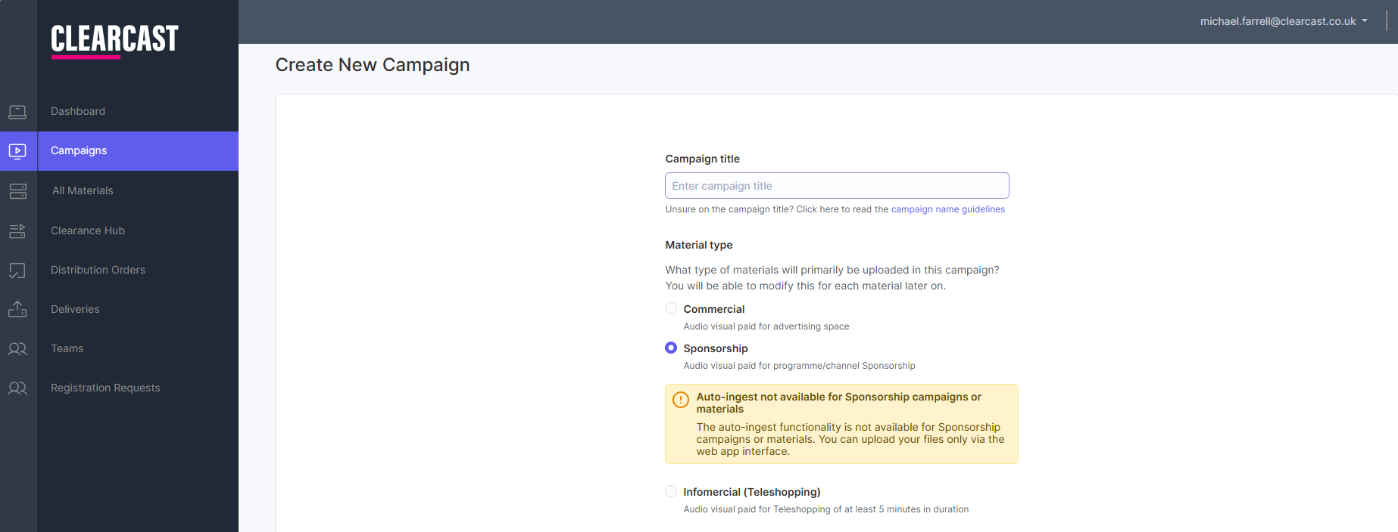
This will be the name of your campaign you are setting up.
This is where you will create your campaign. You cannot upload material without a campaign.
You must select the sponsorship material type option to start up your sponsorship campaign.

Slide 4
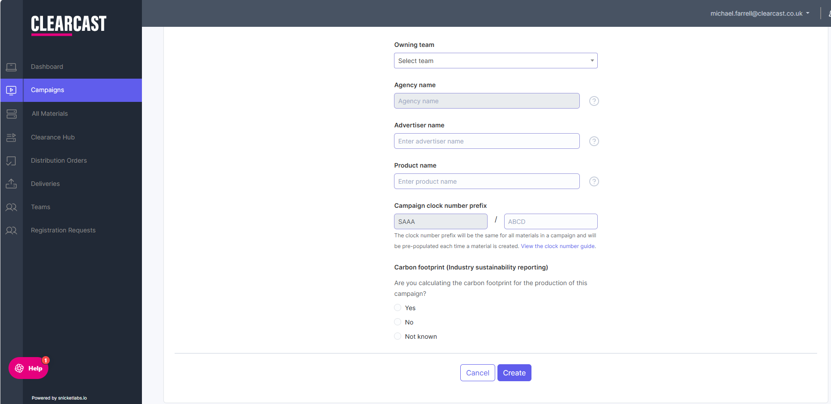
This will determine which existing team owns this campaign and you must select an option from the drop down. This will also auto populate the ‘Agency name’ section.
Click here for further explanations on each option.
Your prefix for sponsorship will be four letters beginning ‘S’ in line with the Sponsorship clock format and Clearcast will assign this to you. The rest of the Clock Number will be for you to create.
It’s recommended to use letters that would represent your brand and sponsorship programme deal. For example, Marks & Spencers - BGT would look like ‘MSBG’.
Click here for guidance on creating your clock number.
Click ‘Create’ upon completing all the above fields.

Slide 5
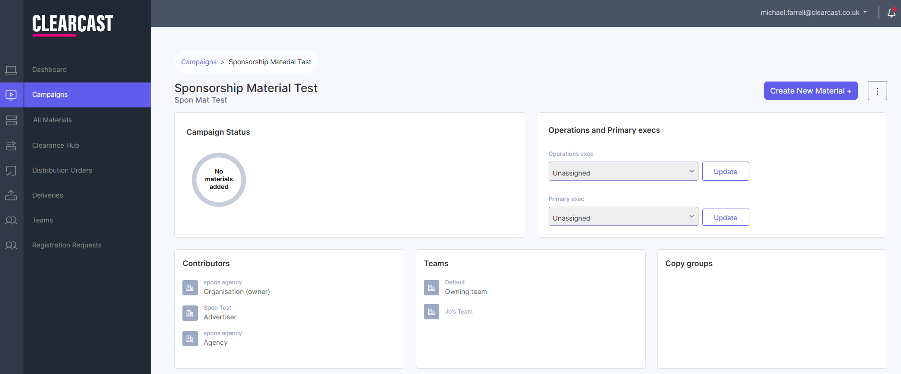
Now you have created your Sponsorship Campaign, select the box on the right to create your material.
This section will show you any existing material you’ve created within your selected campaign.

Slide 6
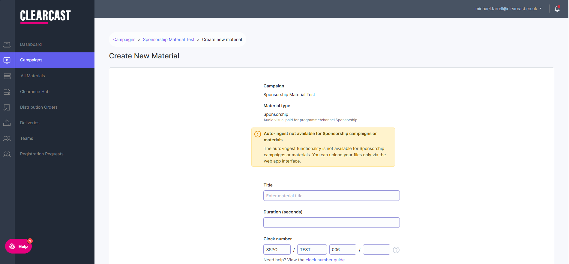
This will be the title of your sponsorship material.
Enter your duration here and your full clock number will be created.

Slide 7
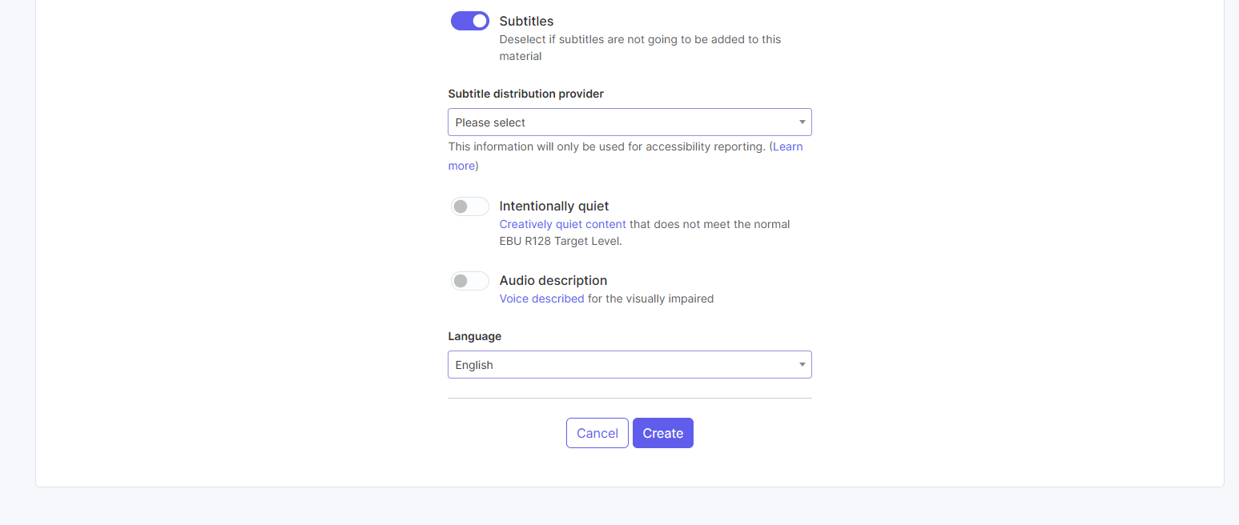
It is now mandatory to have your material subtitled if it is airing on C4.
If you’d like to subtitle your material with us, ensure the toggle is on and that you’ve chosen ‘Clearcast’ as your distribution provider. Please note this is a chargeable service.
Toggle this switch on to indicate your edit is intentionally/creatively quiet. This will override our audio QC.
Toggle to indicate that your material contains AD.
Click ‘Create’ to save your material. This does not submit it for distribution.

Slide 8
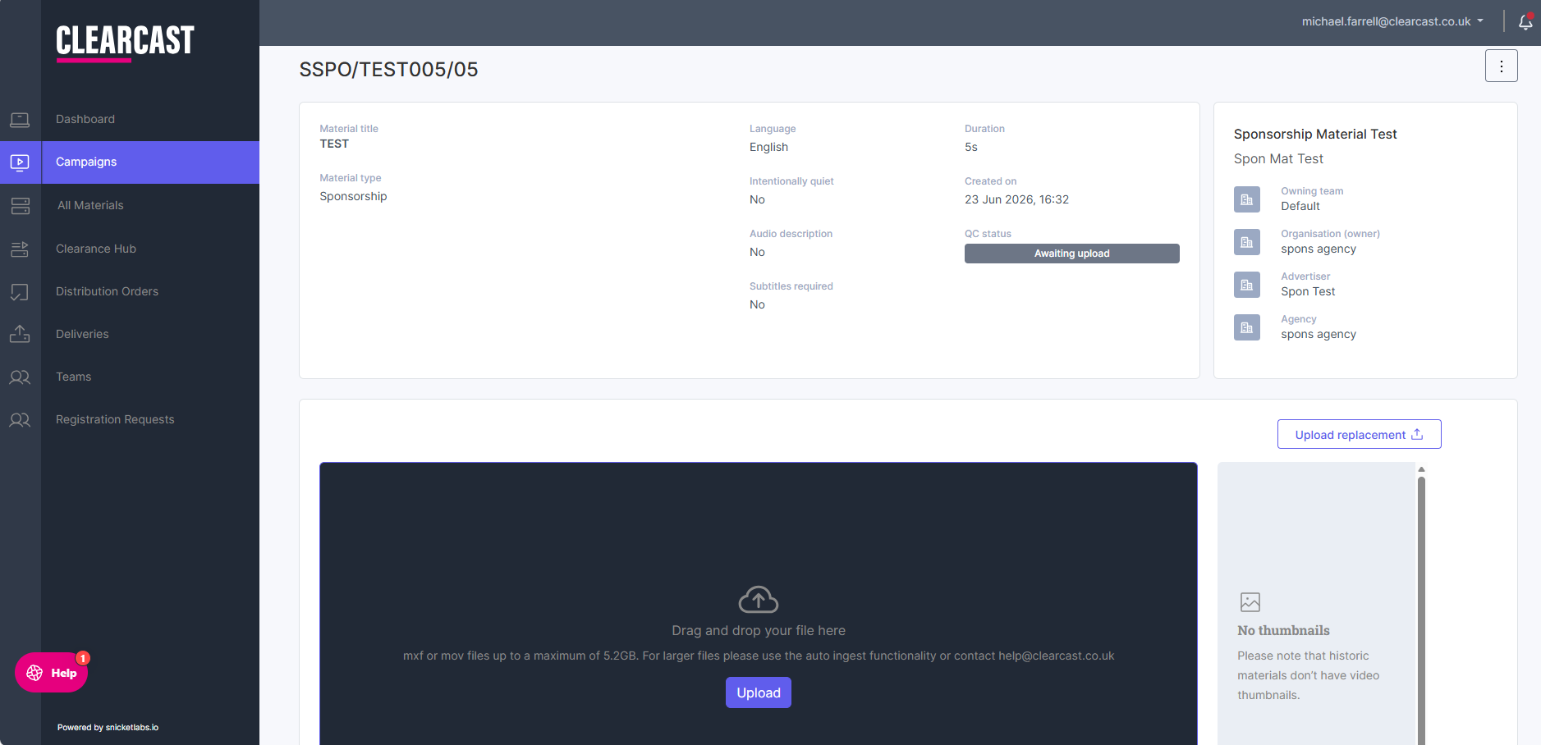
Now you have created the material, all the information you have provided will be on display.
Click here to upload your file/asset.

Slide 9
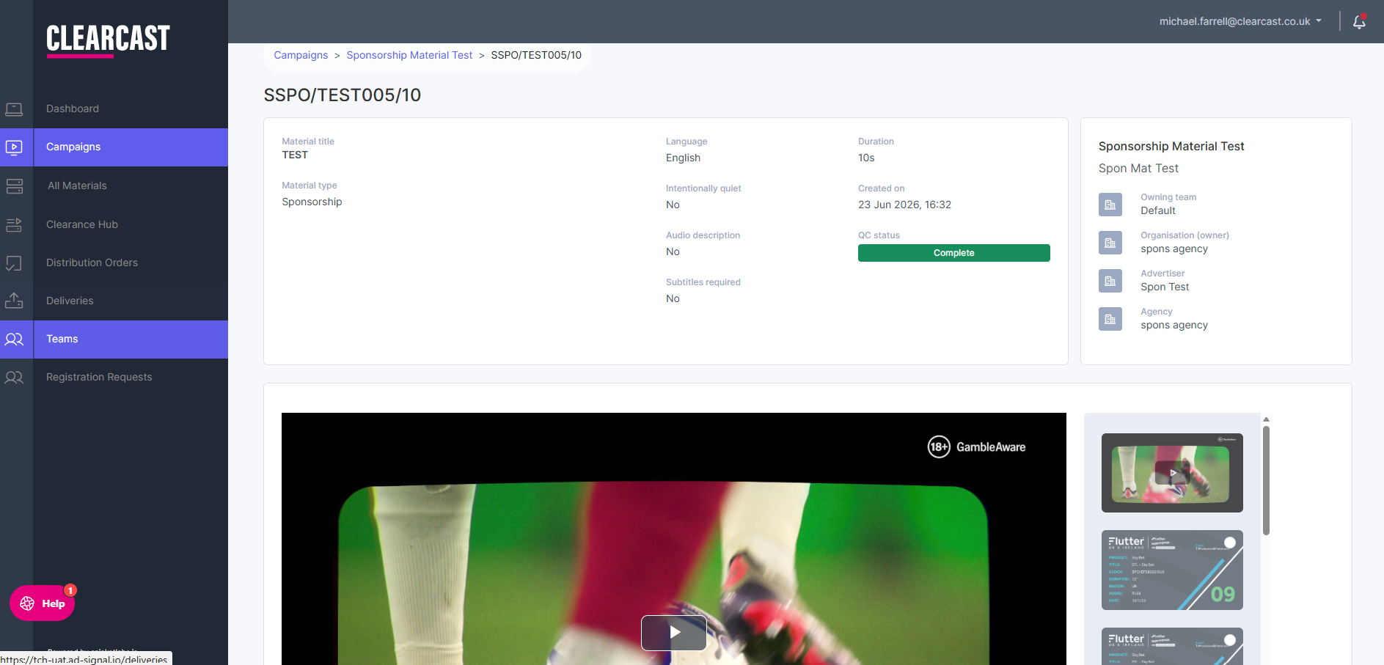
Your uploaded content will display once QC has passed.
Check your QC status here.

Slide 10
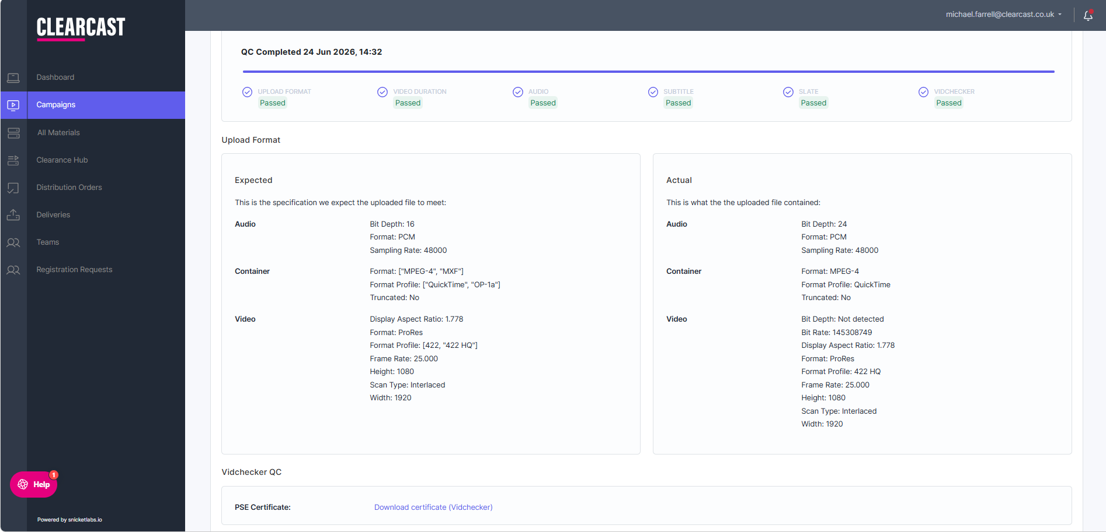
Your asset will run through six QC levels. You can track the progress here.
During the QC process, each field will update to reflect pass or fail results.
Download your PSE certificate here.

